Slide 1
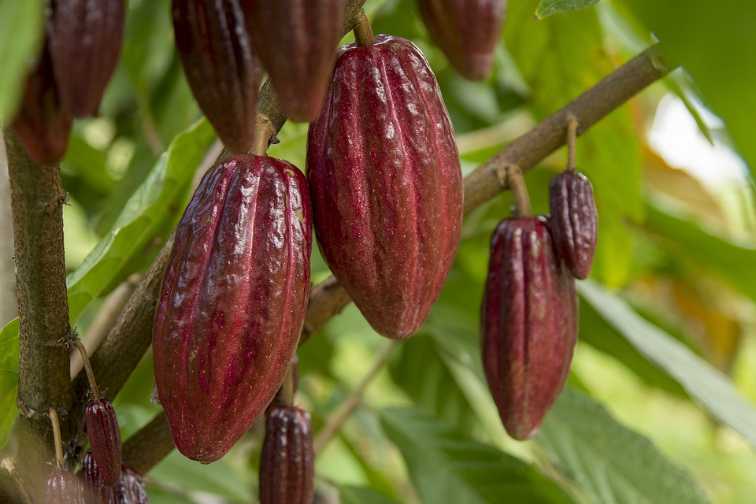
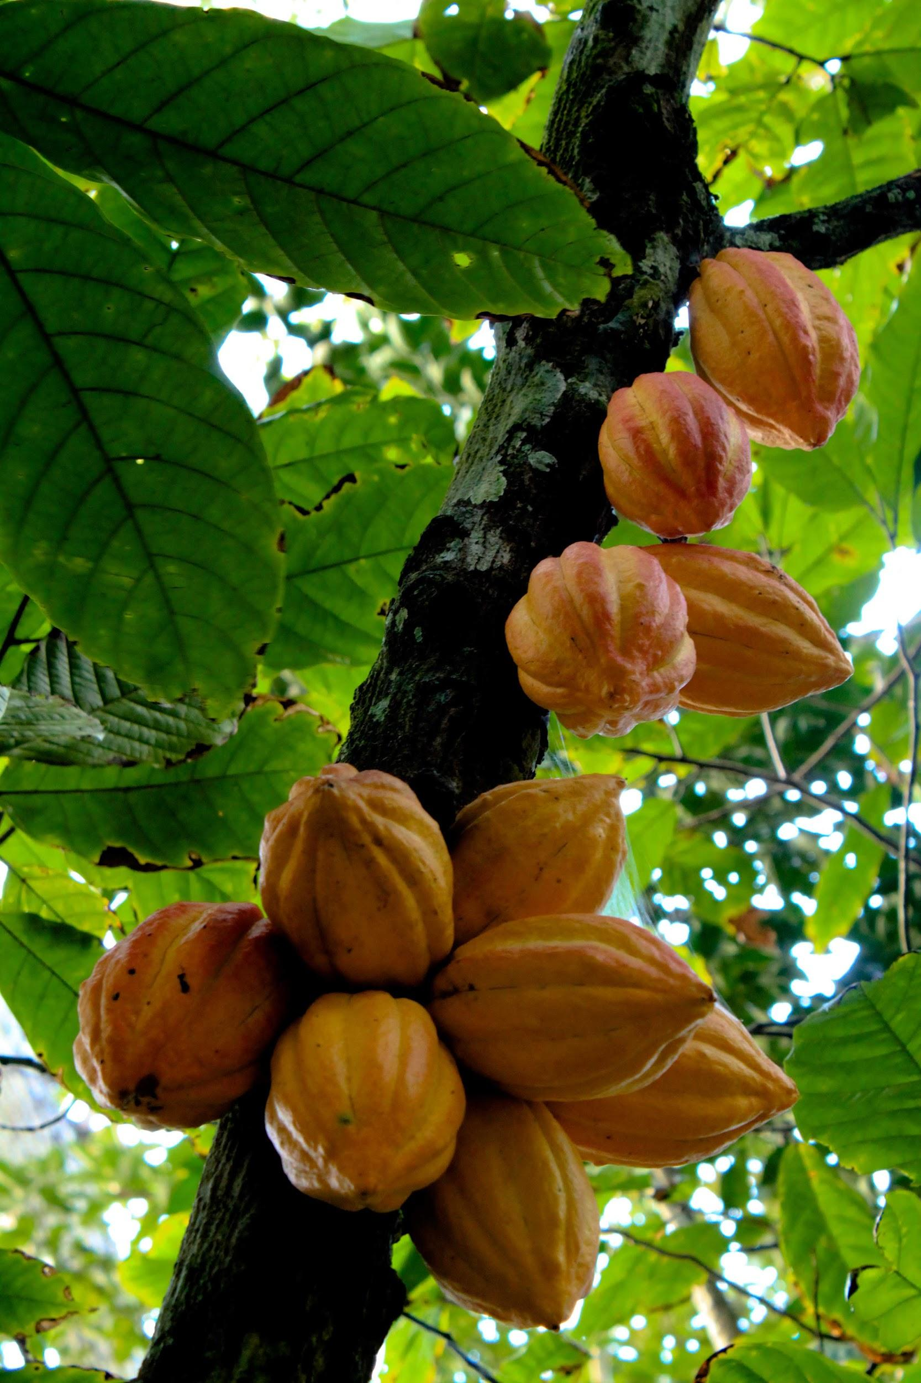
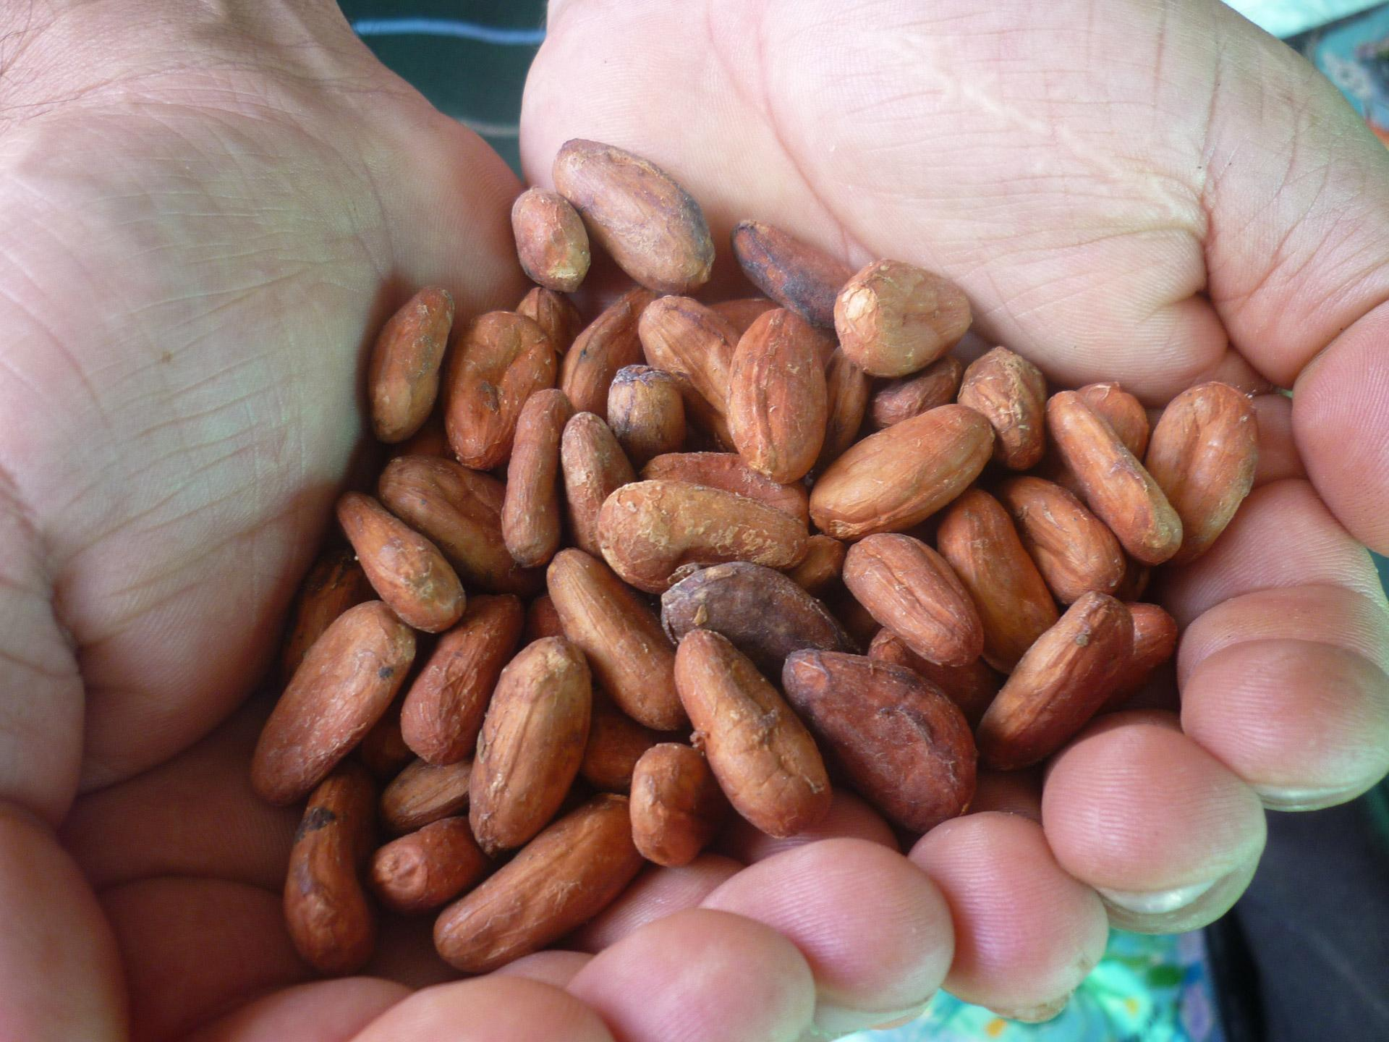
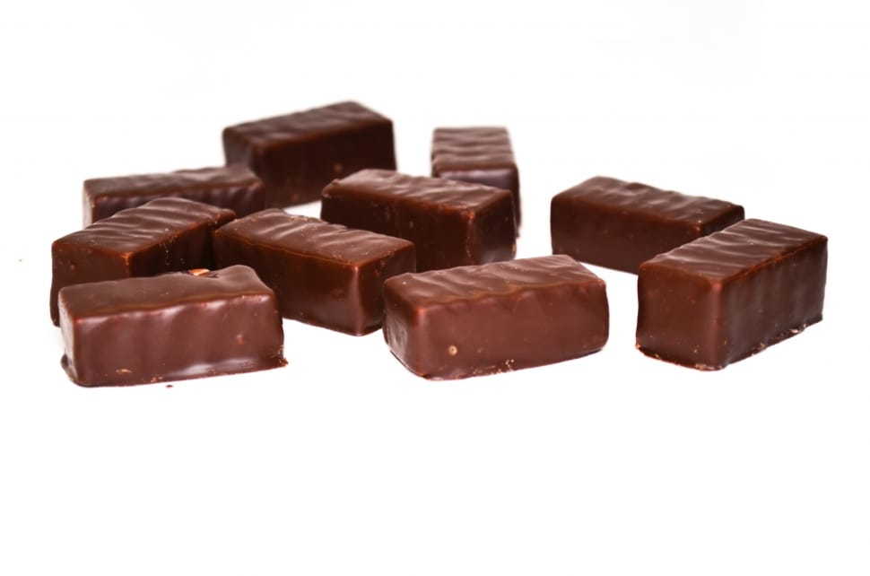
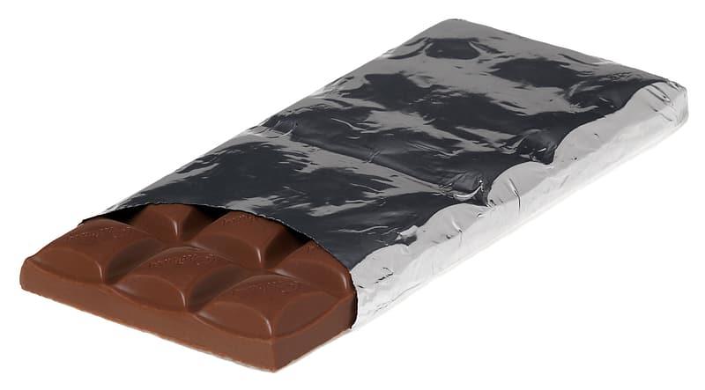

Chocolate Bar Ratings Predictor
Team Candy
Bruce Jilek, Tahereh Javaheripour, Yan Kin Pang, Travis Loseke

Slide 2
Data Preprocessing and Cleaning
Pandas will be the primary avenue for cleaning and preparing the data

Slide 3
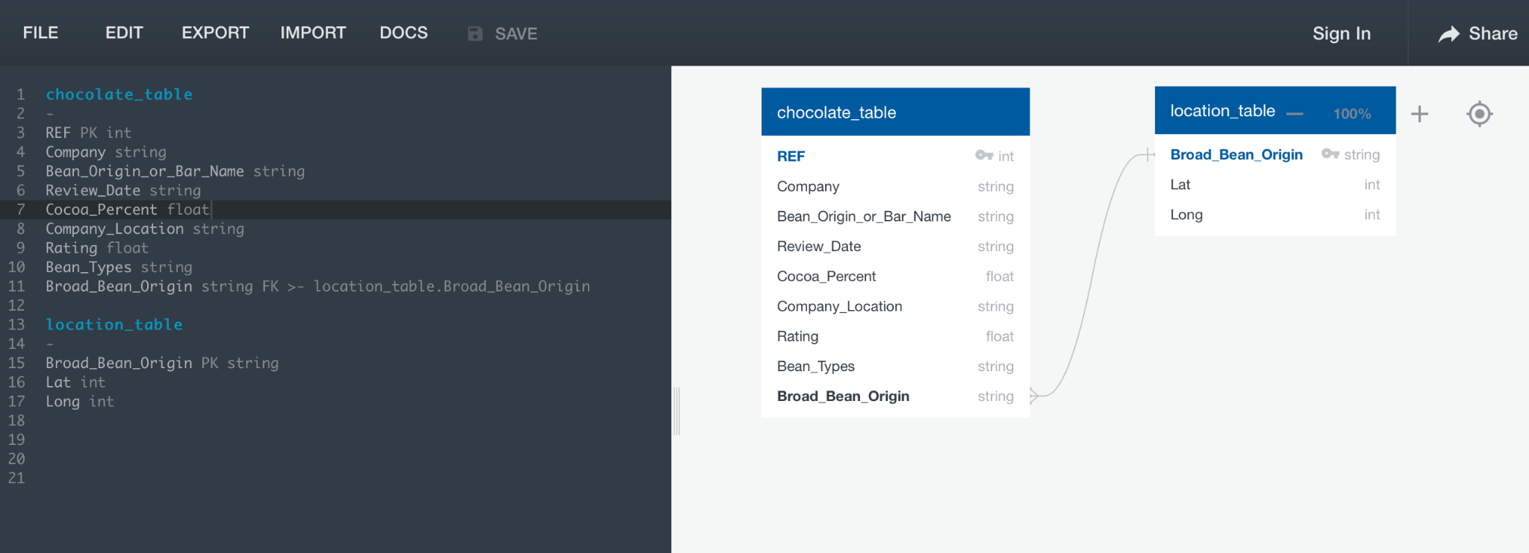
Database Structure
AWS Database- Postgres SQL Database
ERD:

Slide 4
Machine Learning Model
Kera Neural Network
Investigating others)

Slide 5
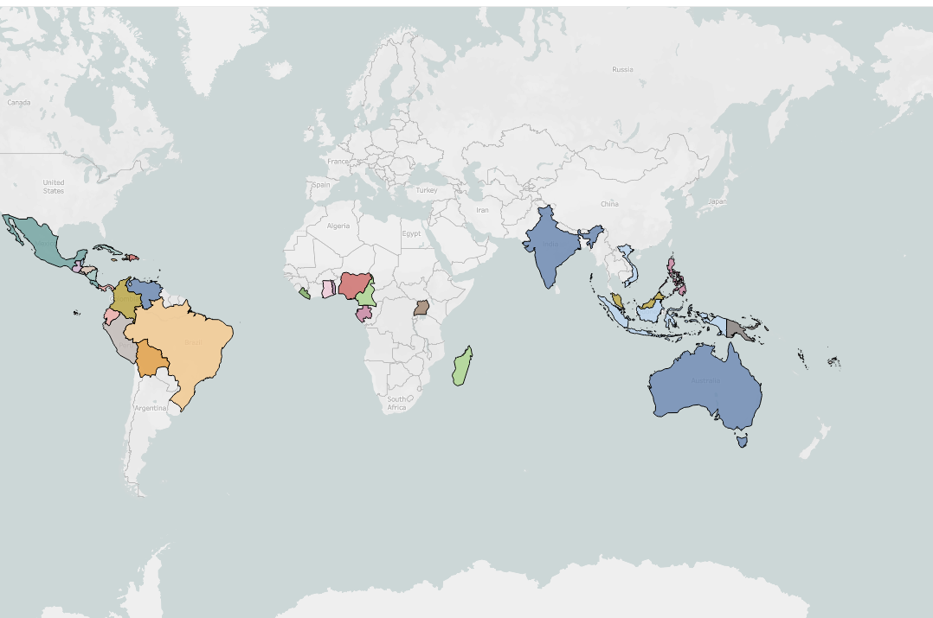
Dashboard
Tableau-
Global Chocolate production

